Slide 1
iSpindel Rapid Start - Contents
Overview
Preface
Cherry Philip Board Layout
Batteries
Charging
First Contact - WiFi connection
BrewFather Connection
Gravity Calculation Polynomial Generation (Rapid Version)
The longer ‘quick start’ guide is here:
https://drive.google.com/open?id=19A07WmQ3VS27igYJXsUmOvKqMiIy_CmG

Slide 2
1 Overview - Preface
The iSpindel uses the same theory as the Tilt. The angle of an unbalanced floating body can be plotted against the gravity and hence gravity derived from that angle.
First up the documentation is pretty good and it’s here:
http://www.ispindel.de/docs/README_en.html

Slide 3
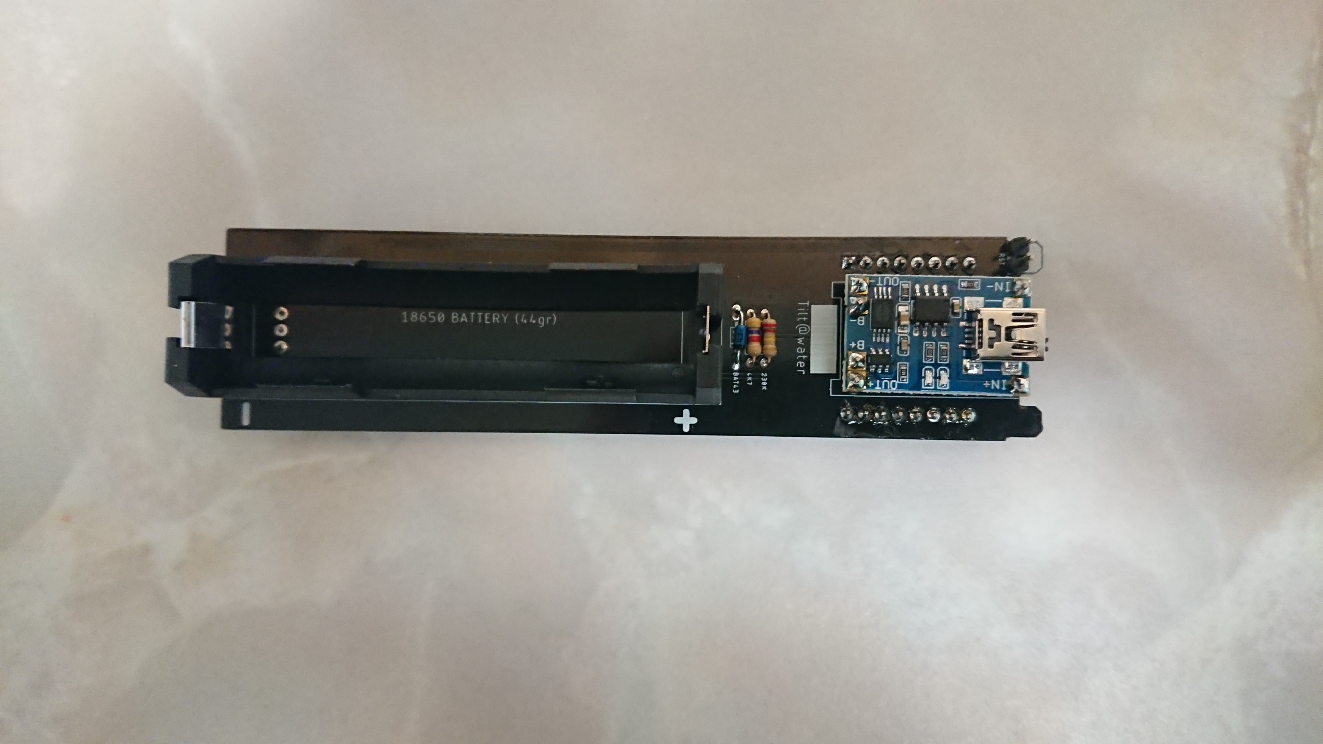
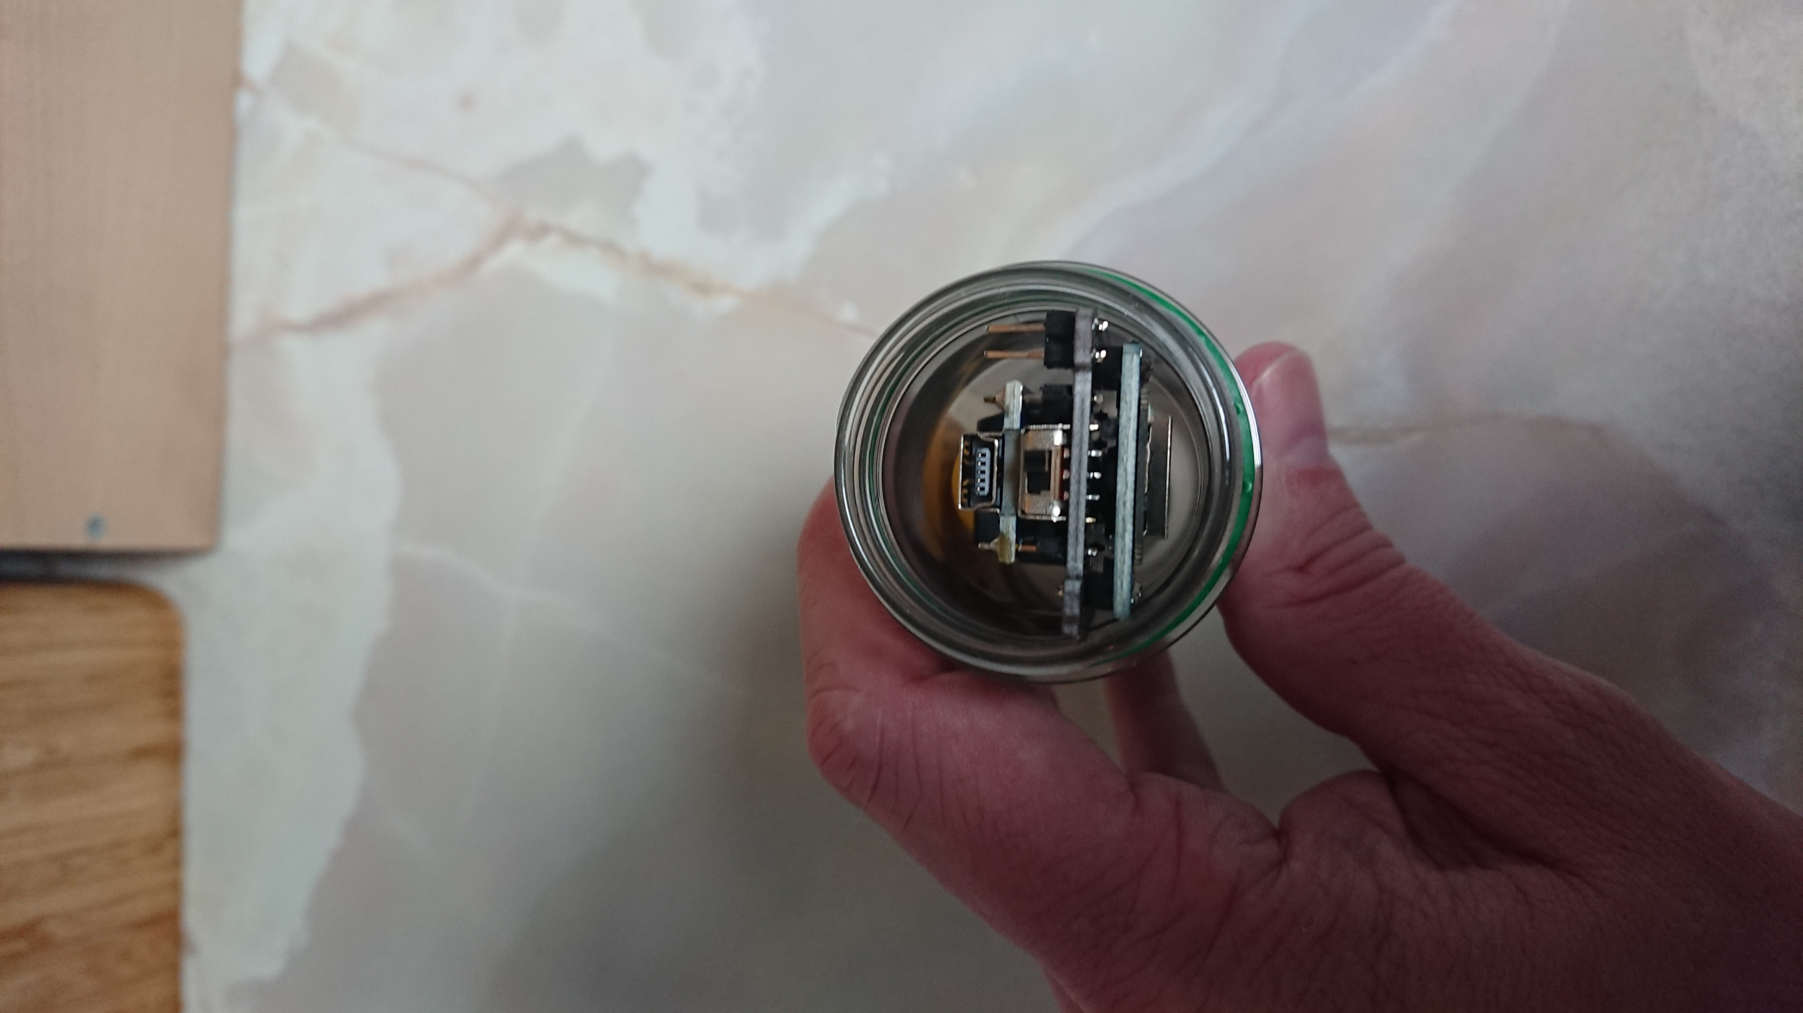
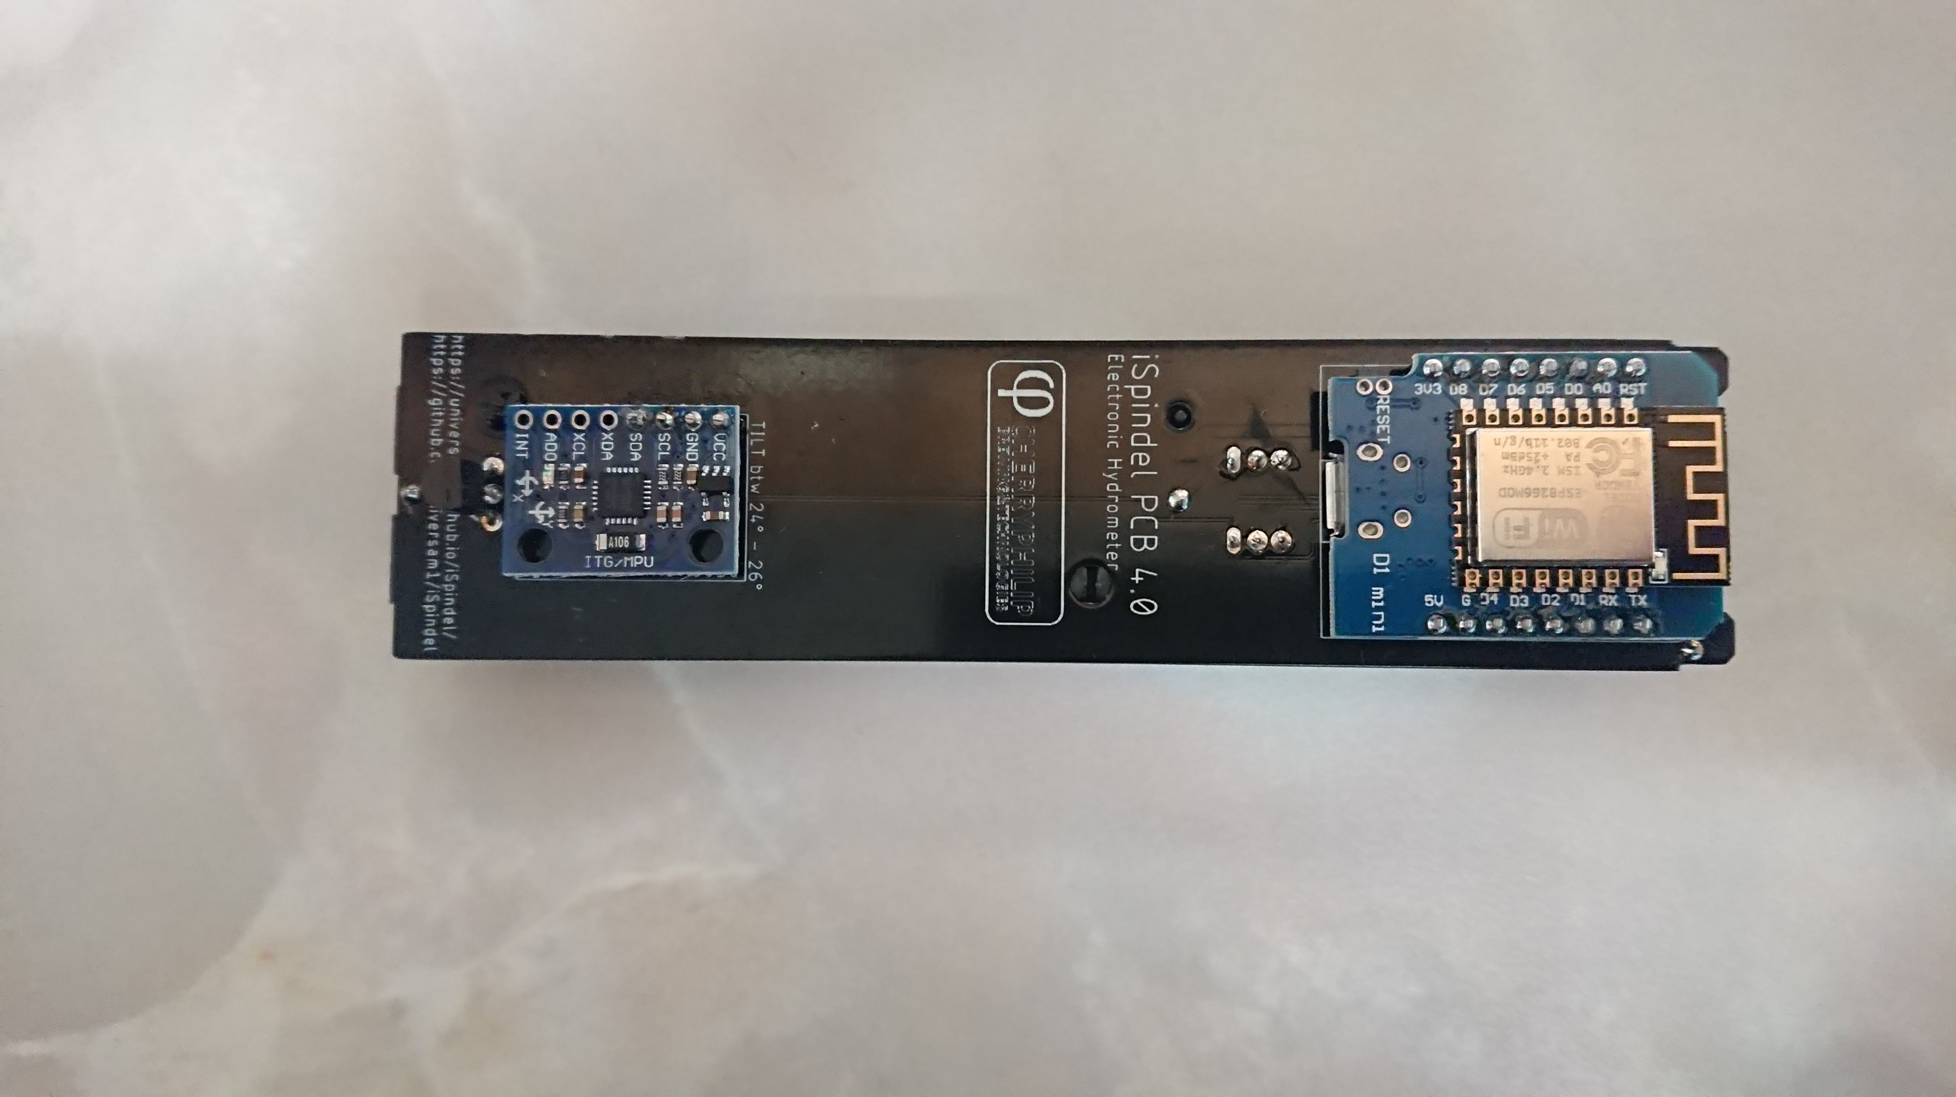
1 Overview – Cherry Philip v4.0 Board Layout
4
Battery
Resistors and Diode
Lipo Charger
Reset Contacts
Temp Sensor
Gyro Board
Wemos Board
Charge Port
On/Off switch
Programming Port
2
1
3
8
4
9
7
5
6
10

Slide 4
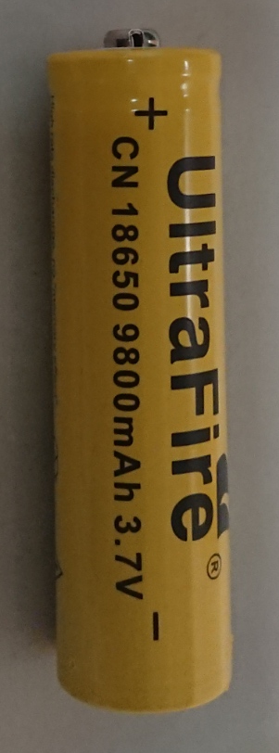
2 Batteries
There are a lot of fake batteries out there so stay away from eBay and use Amazon with great care
They can be dangerous but usually are just very low capacity
Batteries are any of the 18650 types and should weigh over 42g.
If the seller doesn’t advertise battery weight don’t buy from them
If the capacity is much over 3000 mAh it’s fake, like the one opposite
I’d suggest only buying from sites with a real address and phone number who only really sell batteries
These guys seem legitimate:
https://18650.uk/shop/button-top-batteries/
https://www.buyabattery.co.uk/
https://www.batterystation.co.uk/
The battery above is fake no one makes a 9800 mAh battery

Slide 5
3 Charging
There is no need to remove the PCB from the tube to charge the iSpindel, simply plug a USB cable into the charging port noted on slide 3 (Label 8)
Red LED means charging
Blue/Green LED means charged
If the battery is not making contact you will notice that one of the LEDs on the charge board (Slide 3, Label 3) lights and the other dimly flickers.

Slide 6
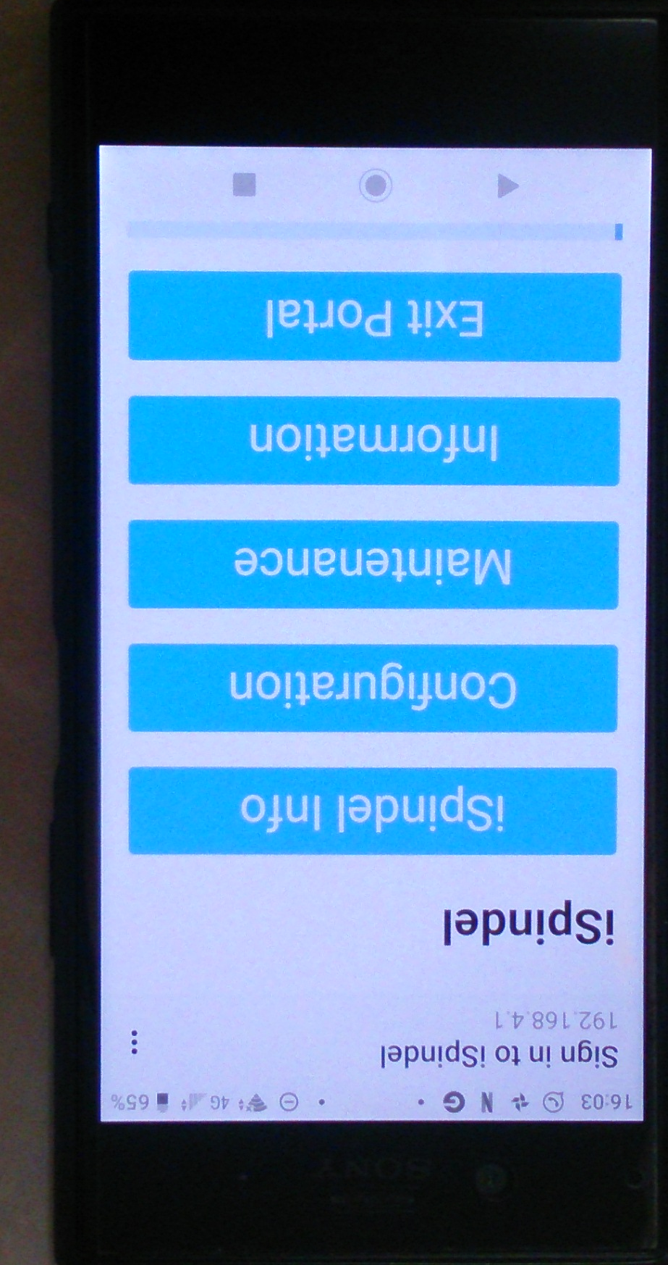
4 First Contact – WiFi connection
Make sure the battery has a good charge in it, see Slide 5 for charging
Turn on the iSpindel and the blue LED (near the top) should blink repeatedly. (If the LED does not blink short the reset contacts twice, see Slide 3, Label 4).
On a mobile device go to your WiFi and join the iSpindel network
It should prompt you to Sign-In, when you do it will take you to its portal
Left long enough this portal will time out (not while you are connected though) to save battery. The device will go to sleep, wake up to send a reading and go back to sleep. To make it serve its portal again you need to short the reset contacts twice.

Slide 7
5 BrewFather Connection
Your iSpindel is setup to report in SG. For brewfather, you must end the name of your device with “[SG]”. I.e. “MyiSpindel[SG]”
See the Brewfather instructions they are pretty good: https://docs.brewfather.app/integrations/ispindel

Slide 8
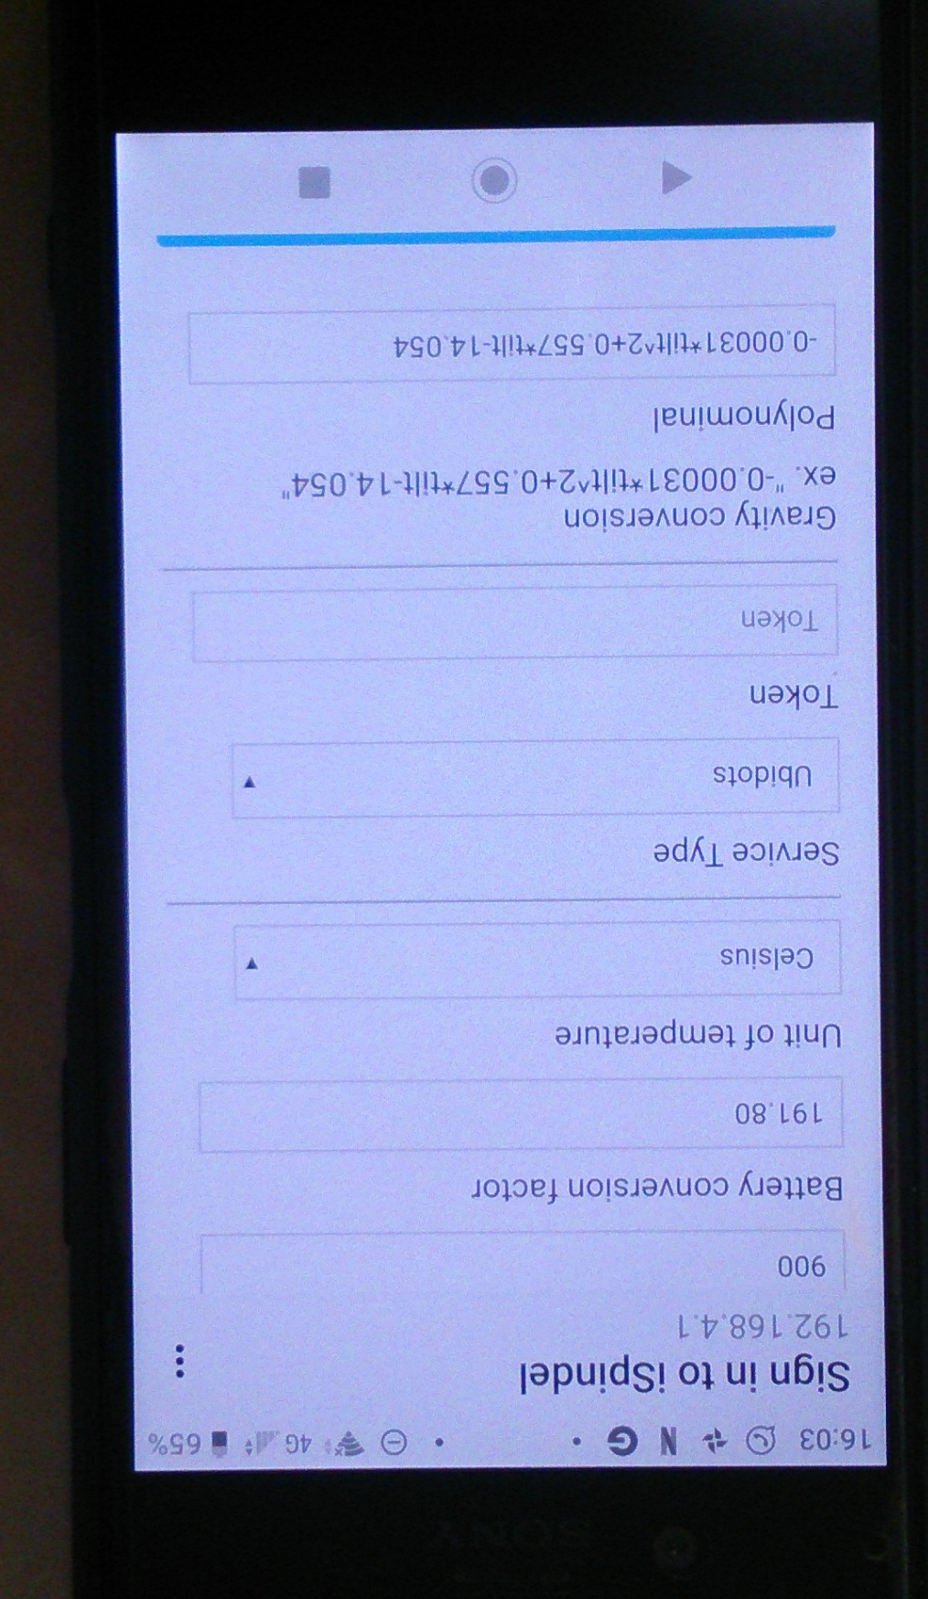
6 Gravity Calculation Polynomial Generation (Rapid Version)
Pop your iSpindel in room temperature tap water
Connect to the portal to read the iSpindel tilt reading
The following spreadsheet can be used to estimate the polynomial needed based on readings from other Cherry Philip based iSpindels:
https://drive.google.com/file/d/1HSDzV-Ri2Rl4ieSaZXOEopSM4OtsoCW1/view?usp=sharing
Follow the instructions to generate the polynomial and copy into the Polynomail box in the iSpindel setup page.

Slide 9
Enjoy playing with the iSpindel project!
Thanks go to:
The project creator: https://github.com/universam1
The PCB Designer: https://github.com/cherryphilip74

